Slide 1
Danielle LeGallee
Grant Coordinator
dlegallee@ccbh.net
October 25, 2021

Slide 2
What is Eligibility?
Definition:
Eligibility - meeting the stipulated requirements, as to participate, compete, or work; qualified.

Slide 3
Cleveland TGA Ryan White Part A Eligibility

Slide 4
Cleveland TGA Ryan White Part A Eligibility
Applicants must provide documents establishing the following:
HIV/AIDS diagnosis
Cleveland TGA residency – Currently living in one of these OH counties: Ashtabula, Cuyahoga, Geauga, Lake, Lorain, or Medina.
Low income – Monthly income must be at or below 500% of the current Federal Poverty Level (FPL) for all service categories.
Uninsured or underinsured – Agencies must explore and eliminate all other possible sources of third party payment before using Ryan White funds to pay for a service(s). Clients with insurance or access to insurance must submit documentation of coverage.

Slide 5
New HRSA Guidelines
Eligibility only needs to be established once per year, effective immediately.
6NC documentation is no longer needed.
New documentation must still be uploaded if a client’s insurance, residency, or income status changes.
Providers should utilize all available resources to confirm eligibility before reaching out to the client.
ie. Information obtained from agency’s EMR or another database.
This lessens the burden on the client.
Staff are highly encouraged to check in with client intermittently throughout the year to ensure client eligibility is maintained.
Immigration status is irrelevant to eligibility.
As long as clients can provide proof that they are living in the Cleveland TGA, they are eligible for services regardless of immigration status.

Slide 6
Electronic Eligibility
Documentation Requirements
Document Type | New Eligibility | Annual Eligibility | Semi-Annual Eligibility (No Changes)
Application |  |  | No longer needed
Residency |  |  | No longer needed
Income |  |  | No longer needed
HIV Status |  |  | No longer needed
Insurance |  |  | No longer needed

Slide 7
Electronic Eligibility
Eligibility is established when all verification and documentation criteria are met and up to date.
HIV status, income, residency, insurance
If one eligibility factor changes (income, insurance, residency), then a new full application will have to be completed and uploaded, along with all of the supporting documentation.
Ex: If a client moves, then a full application will have to be completed regardless of expiration date of the previous application (income and insurance must be uploaded again as well).
Ryan White is the payer of last resort.
Agency eligibility staff must screen the client for other potential third-party payers and assist the client in completing related applications, as needed.
All supporting documents MUST be uploaded into CAREWare within 3 business days.
Uploaded documentation is required before services are billed.
Staff can continue to sign eligibility applications on behalf of client.

Slide 8
Eligibility File Naming Format
The following chart outlines the naming format by eligibility document type:
Please ensure that each file is uploaded with 2 digits for the month, 2 digits for the date, and 2 digits for the year, followed by the appropriate spacing and abbreviation. No extra numbers or letters should be added.
Ex: 10 25 21 POI
Eligibility Document | File Name Format
Eligibility Application | mm dd yy APP
Proof of Residency | mm dd yy RES
Proof of Income | mm dd yy POI
Proof of HIV Status | mm dd yy HIV
Proof of Insurance | mm dd yy INS

Slide 9
Electronic Eligibility Steps
Complete full eligibility application once per year.
Include all supporting documentation (HIV status, residency, income, and insurance).
Scan eligibility documents and save in proper file naming format.
Upload documents to the “Attachments” tab in client’s CAREWare account within 3 business days.
Tab located in CAREWare’s shared domain.
Update client eligibility record under “Eligibility” on Demographics page in CAREWare.

Slide 10
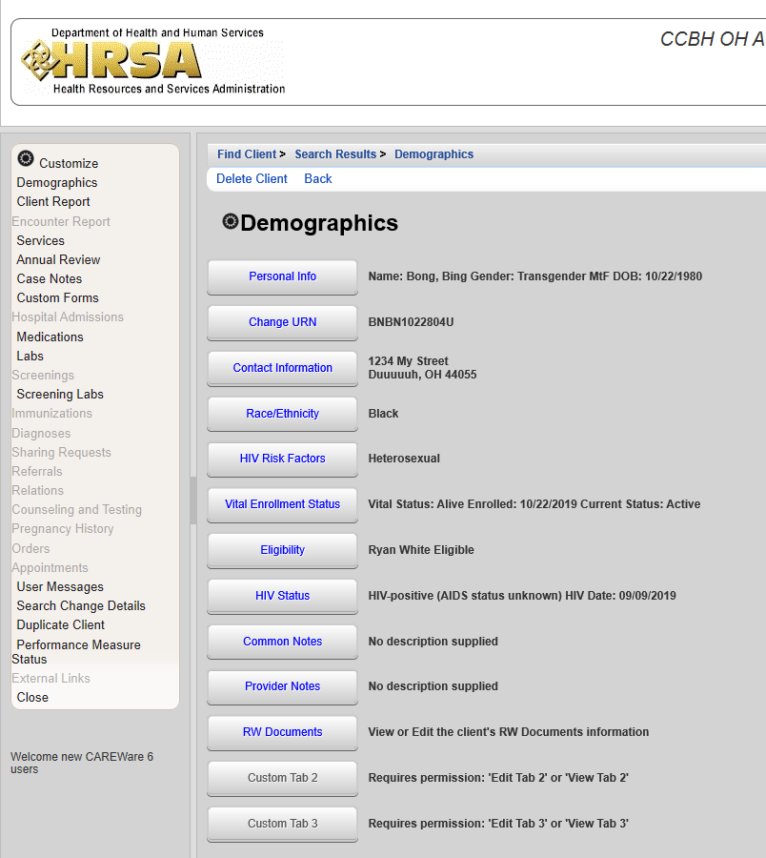

Slide 11
Eligibility Responsibility
“...the responsibility for documenting the provision of allowable services to eligible clients rests with the agency providing services.”
Review documents BEFORE seeing clients.
Are eligibility requirements met? Is eligibility current?
View the uploaded files to ensure that they are correct, do not just look at the dates the files were uploaded.
Documents should be uploaded within 3 business days.
This is important to ensure that another provider does not complete a duplicate eligibility application because yours was not uploaded.
Agencies cannot delete files in CAREWare.
If a file needs to be deleted, please reach out to the CCBH CAREWare contact:
Danielle LeGallee at dlegallee@ccbh.net or 216-201-2000 x1366.
Step by step instructions in CAREWare Manual (starts on page 19).

Slide 12
2021 Eligibility Monitoring
2021 eligibility monitoring will be adhering to the former guidelines.
ie. Eligibility established every 6 months.
Next eligibility monitoring will be in accordance with the new guidelines.
Agencies are still responsible for ensuring that all client information is updated in CAREWare before providing services.
Again, double check the files that are currently in the client’s record to ensure they are the correct documents.

Slide 13
Frequent Mistakes
Re-uploading the exact same file that was uploaded at last recertification.
Need updated documentation for full eligibility application, even if information has not changed.
Date incorrect on Eligibility Application.
File must be named by the date eligibility was completed, not the date that the document was uploaded.
Eligibility being completed too often.
Check the client’s eligibility documents that are already uploaded before completing additional documents.
Self attestation statements should be last resort, and are only permitted if client receives zero income.
Cannot be used for residency, HIV status, or insurance – these must be legal documentation.
Cannot be written by a provider.

Slide 14
Frequent Mistakes
HIV Status uploaded multiple times.
Proof of HIV status is the ONLY documentation that can be uploaded one time ever, not every year.
If one document (i.e. proof of Medicaid) is being used for multiple aspects of eligibility, it needs to be uploaded in EACH category.
Not adhering to the file naming format (ie. MM DD YY APP).
Each full eligibility application should be accompanied by new proof of residency, insurance, and income.
If any information changes, a new full eligibility application must be completed.
Documentation does not have identifying client information.
Ie. Social Security benefits award letter with the amount, but without the page with the client’s name.

Slide 15
Electronic Eligibility Documents
All Electronic Eligibility documents are available on our website!
http://www.ccbh.net/ryan-white/

Slide 16
Summary
New HRSA guidelines
Eligibility only needs to be established once per year (6NC no longer needed).
Utilize all available resources to confirm eligibility before reaching out to the client.
Staff are highly encouraged to check in with client intermittently throughout the year to ensure client eligibility is maintained.
Immigration status is irrelevant to eligibility.
The agency providing the service is responsible for ensuring eligibility requirements are met and current in CAREWare.
Best practice is to review clients’ eligibility in advance the week before upcoming appointments.
This includes checking the uploaded documentation and not just looking at the date it was uploaded.
Ensure documents are being uploaded within 3 business days with the appropriate file naming format.
2021 Eligibility Monitoring will be adhering to former HRSA guidelines.
If you have additional questions or concerns, reach out to the CCBH CAREWare contact:
Danielle LeGallee at dlegallee@ccbh.net or
216-201-2000 x1366.

Slide 17
Ryan White Part A
Cleveland TGA

