Slide 1

Providing Culturally Humble Care to LGBTQ+ Individuals and PLWH

Slide 2
Objectives
Explain the difference between sexual orientation and gender identity and the issues of privilege related to both.
Explain the concepts of cultural competency and cultural humility.
Describe health disparities/inequities experienced by LGBTQ+ community.

Slide 3
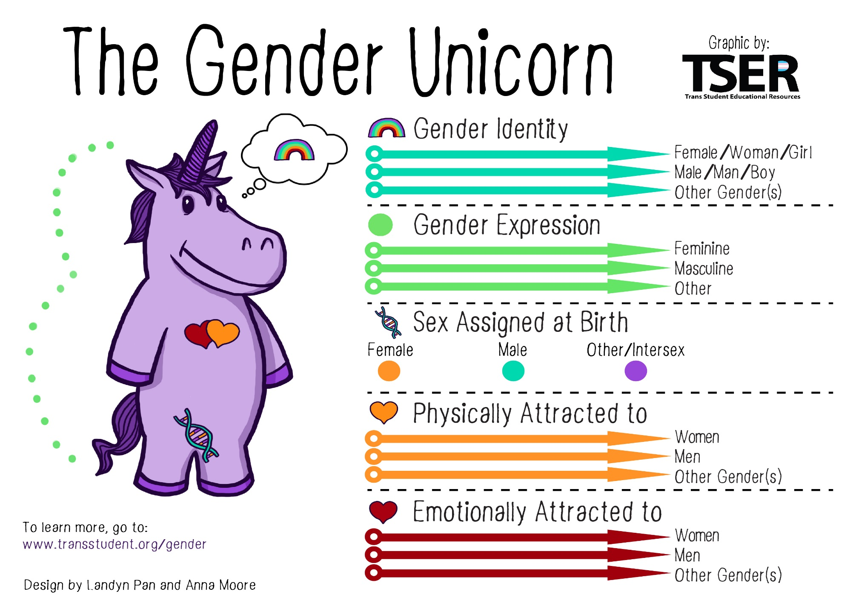

Slide 4
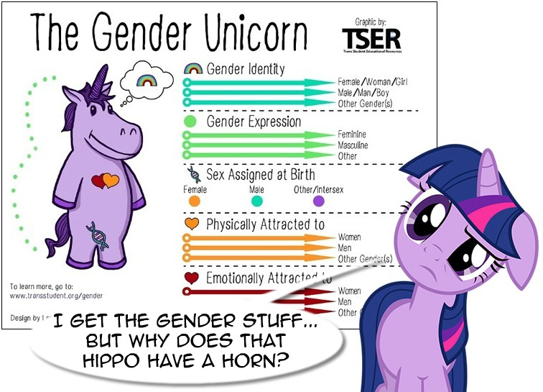
Decoding the Gender Unicorn
Sexual Orientation
  Homosexuality
  Heterosexuality
  Bisexuality
  Etc.
Gender Identity
  Cisgender
  Transgender
  Etc.
Fluidity
  Queer
  Questioning

Slide 5


Gender Norm Socialization
As a society what do we divide based on ‘gender’ besides people?
What happens if people act or express themselves in ways that don’t fit gendered expectations?
EquitasHealthinstitute.com

Slide 6
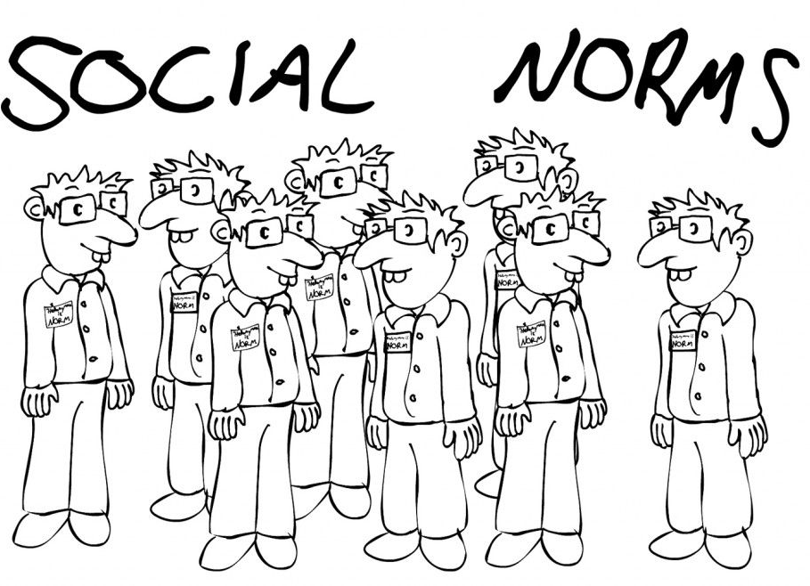
Social Norms
“Norms are the established standards of behavior maintained by a society.” –Richard Schafer
Heteronormativity
Cisnormativity
Heterosexism
Homophobia
Transphobia

Slide 7
Striving for Health Equity
Health Equity is:
  Fairness in the distribution of resources between groups with differing levels of social advantage
  Creating an environment where everyone has a good chance to be healthy

Slide 8
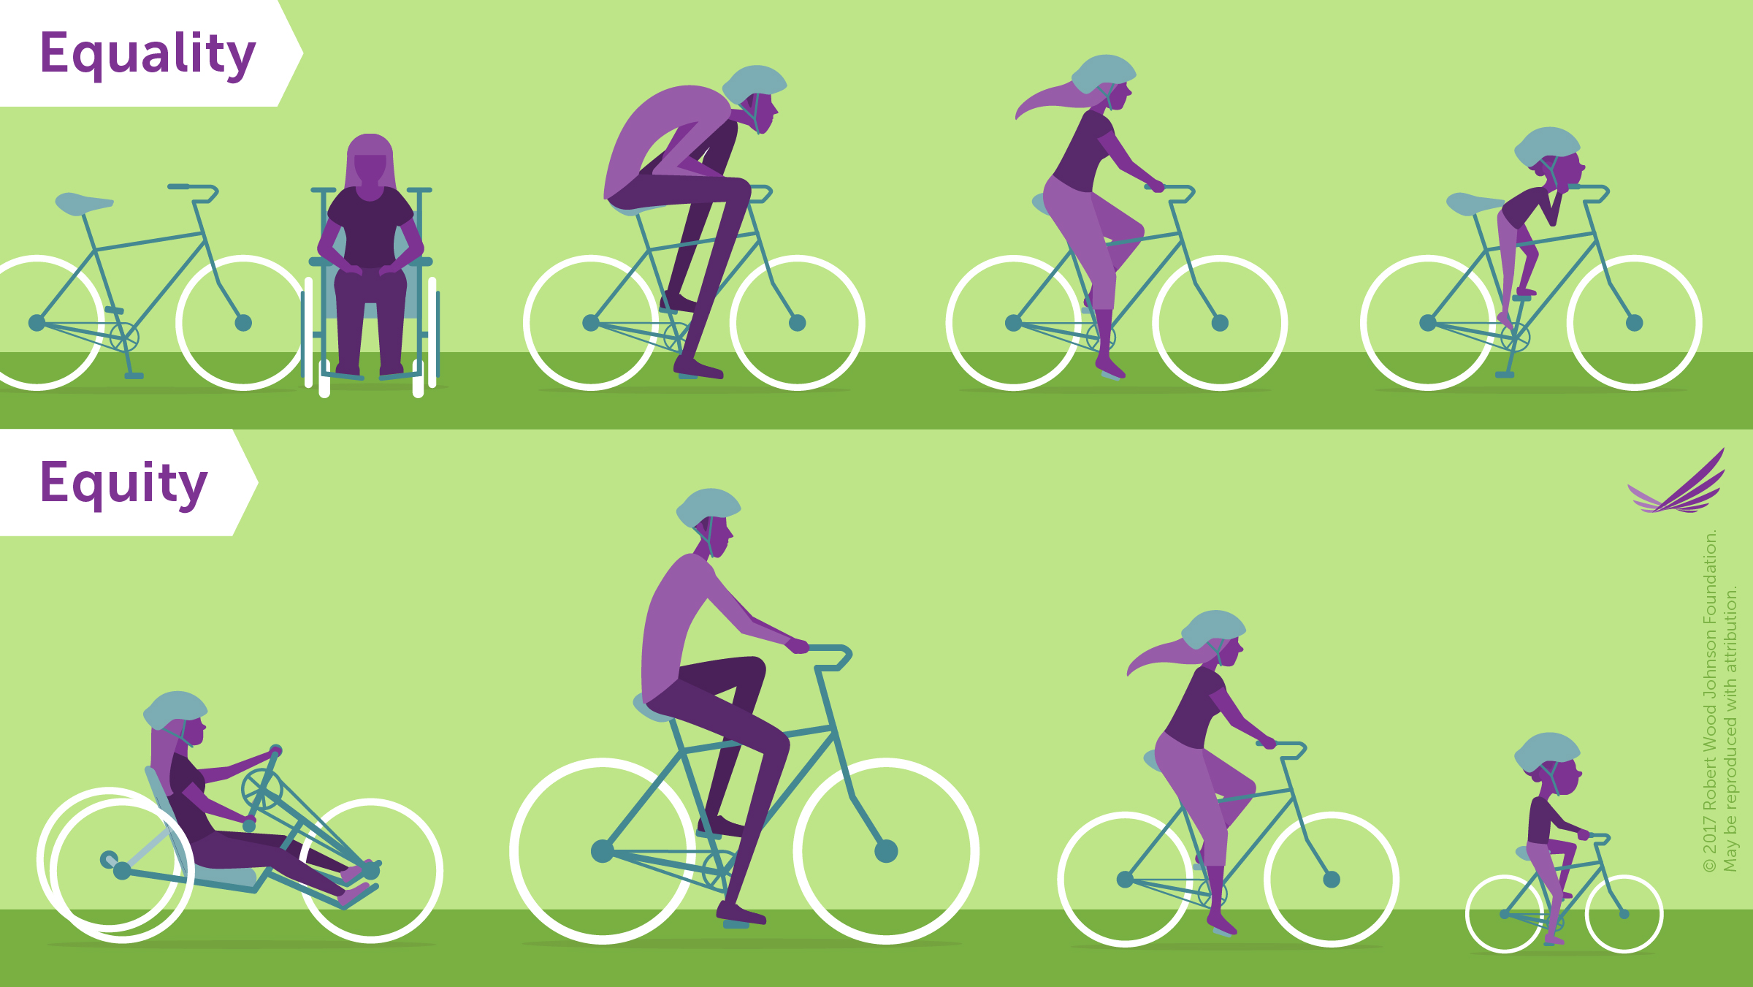
Equality vs. Equity

Slide 9
Health Inequity Explained
Systematic: Inequities and their consequences are not ‘random’ but follow a ‘pattern.’
Socially produced: The ‘patterns’ produced by inequities can be traced back to the social determinants of health (neighborhood, education, social norms, access to care, food security, etc.) In this case homophobia, heterosexism, transphobia.
Unfair: Inequity has an ethical and moral connotation, which is embodied in a sense of ‘injustice.’

Slide 10
Health Disparities/Inequities Experienced by LGBTQ+ Community
Suicide (LGBT youth 2-3 mores times likely to attempt)
Homelessness (it is estimated that up to 40% of homeless youth are LGBTQ+)
Breast and Cervical Cancer rates higher for applicable LGBTQ+ individuals; lesbians less likely to get cancer screenings
“Report on Lesbian, Gay, Bisexual and Transgender Health,” Healthy People.gov
http://healthypeople.gov/2020/topicsobjectives2020/overview.aspx?topicid=25
Notes:
Suicide (LGBT youth 2-3 mores times likely to attempt)
Homelessness (it is estimated that up to 40% of homeless youth are LGBTQ+)
Breast and Cervical Cancer rates higher for applicable LGBTQ+ individuals; lesbians less likely to get cancer screenings
HIV (70% MSM)
Obesity (more likely for lesbian and bisexual women)
Alcoholism, tobacco use (WSW smoke 200% more)
Disproportionately face mental health challenges (response to trauma/stigma, barriers to care)
Increased numbers of all for trans community specifically and LGBTQ+ people of color
“Report on Lesbian, Gay, Bisexual and Transgender Health,” Healthy People.gov
http://healthypeople.gov/2020/topicsobjectives2020/overview.aspx?topicid=25

Slide 11
Health Disparities/Inequities Experienced by LGBTQ+ Community
HIV (66% MSM)
Obesity (more likely for lesbian and bisexual women)
Alcoholism, tobacco use (WSW smoke 200% more)
Disproportionately face mental health challenges (response to trauma/stigma, barriers to care)
Increased numbers of all for trans community and LGBTQ+ POC
“Report on Lesbian, Gay, Bisexual and Transgender Health,” Healthy People.gov
http://healthypeople.gov/2020/topicsobjectives2020/overview.aspx?topicid=25
Notes:
Suicide (LGBT youth 2-3 mores times likely to attempt)
Homelessness (it is estimated that up to 40% of homeless youth are LGBTQ+)
Breast and Cervical Cancer rates higher for applicable LGBTQ+ individuals; lesbians less likely to get cancer screenings
HIV (70% MSM)
Obesity (more likely for lesbian and bisexual women)
Alcoholism, tobacco use (WSW smoke 200% more)
Disproportionately face mental health challenges (response to trauma/stigma, barriers to care)
Increased numbers of all for trans community specifically and LGBTQ+ people of color
“Report on Lesbian, Gay, Bisexual and Transgender Health,” Healthy People.gov
http://healthypeople.gov/2020/topicsobjectives2020/overview.aspx?topicid=25

Slide 12
2009 Lambda Legal Survey*: Discrimination and Barriers to Care in LGBT Community
56 % LGB and 70% Trans and GNC report at least one experience of:
Being refused care
Health care professionals refusing to touch patient or using excessive precautions
Health care professionals using harsh or abusive language
Being blamed for their health status
Health care professionals being physically rough or abusive
* When Health Care Isn’t Caring: Lambda Legal’s Survey of Discrimination Against LGBT People and People with HIV (New York: Lambda Legal, 2010) www.lambdalegal.org/health-care-report

Slide 13
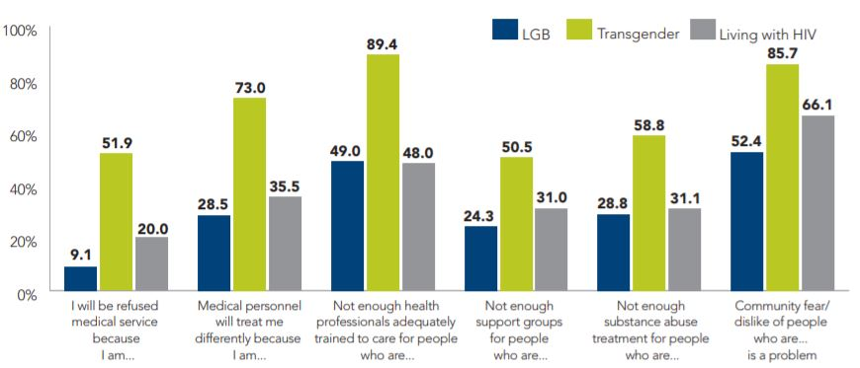
Fears and Concerns About Accessing Healthcare
When Health Care Isn’t Caring: Lambda Legal’s Survey of Discrimination Against LGBT People and People with HIV (New York: Lambda Legal, 2010) www.lambdalegal.org/health-care-report
Notes:
This chart, also from the Lambda Legal survey, helps illustrate some basic problems – Even though Cis LGB people have fewer experiences of discrimination than trans people and people living with HIV, they experience much more discrimination than straight cis-identified patients. Among trans folks and people living with HIV, those issues are much more pronounced. Most trans people fear that they will be refused medical services, three quarters fear medical personnel will treat them differently because of their gender identity, and ninety percent believe that not enough health professionals are adequately trained to care for trans folks. On a number of topics, people living with HIV have concerns and fears at levels approaching those felt by trans folks.
Given the data, there is clearly a glaring need for LGBTQ-specific training for health care professionals.

Slide 14
Why Cultural Competency/Cultural Humility?
These are important tools for tackling larger issues of health disparities and health inequities.
EquitasHealthinstitute.com

Slide 15

What is “Cultural Competency?”
  The ability of providers and organizations to effectively deliver health care services that meet the social, cultural, and linguistic needs of patients.
  Builds knowledge, awareness, skills and capacity to identify, understand, and respect the unique beliefs, values, customs, languages, abilities and traditions of all people in order to provide effective programs and services.

Slide 16
What is “Cultural Competency?”
  Enables effective work in cross-cultural situations.
  Includes mandates, laws, policies, rules, standards, practices, and attitudes.

Slide 17
Cultural Competency as a Tool to Fight Health Inequity
By creating an environment of cultural competence in health care settings, we reduce the likelihood that people will lose linkage to care (or fail to engage in care in the first place).
Patients are more likely to be honest with their providers, and to engage in preventative care, when they have a welcoming and inclusive experience.

Slide 18

Why is Cultural Competency Not Enough?
Cultural Competency and the “Super Mario Bros.” question.
Can you ever know enough about another culture to “beat the game?”
Organizations might “go through the motions” of ticking boxes on a CC checklist.
Can lead to individual and organizational complacency.
Problem of Implicit/Unconscious Bias.

Slide 19
Implicit/Unconscious Bias
Studies show people can be consciously committed to egalitarianism, and deliberately work to behave without prejudice, yet still possess hidden negative prejudices or stereotypes.
A growing number of studies show a link between hidden biases and actual behavior. In other words, hidden biases can reveal themselves in action, especially when a person's efforts to control behavior consciously flags under stress, distraction, relaxation or competition.
Implicit Bias Test: https://implicit.harvard.edu/implicit/
http://www.tolerance.org/Hidden-bias

Slide 20

Pillars of Cultural Humility: Lifelong Commitment
Cultural Humility is more akin to an “open world” video game like Super Mario Odyssey.
Unlike Cultural Competency, you cannot “beat the game.” CH is a process, not a goal.
Flexibility and openness to learning is crucial, as is being willing to admit you don’t know things and then being willing to ask questions in an inclusive and sensitive manner.
Tervalon, M., & Murray-Garcia, J. (1998). Cultural humility versus cultural competence: A critical distinction in defining physician training outcomes in multicultural education. Journal of Health Care for the Poor and Undeserved, 9, 117-125

Slide 21

Pillars of Cultural Humility: Fixing Power Imbalances
CH also includes a desire to fix power imbalances where none ought to exist.
Patients/clients are experts on their own life, symptoms and strengths.
Providers should approach interactions with patients/clients in a collaborative mindset.
Tervalon, M., & Murray-Garcia, J. (1998). Cultural humility versus cultural competence: A critical distinction in defining physician training outcomes in multicultural education. Journal of Health Care for the Poor and Undeserved, 9, 117-125

Slide 22

Pillars of Cultural Humility: Developing Partnerships
CH also includes developing partnerships with people and groups who advocate for others.
Though individuals can create positive change, communities and groups can also have a profound impact on systems.
CH, by definition, is larger than our individual selves — we must advocate for it systemically.
Tervalon, M., & Murray-Garcia, J. (1998). Cultural humility versus cultural competence: A critical distinction in defining physician training outcomes in multicultural education. Journal of Health Care for the Poor and Undeserved, 9, 117-125

Slide 23
How can we put these principles into practice?
Let’s look at how an approach of CC/CH can create more welcoming and inclusive environments for trans and non-binary folks.

Slide 24
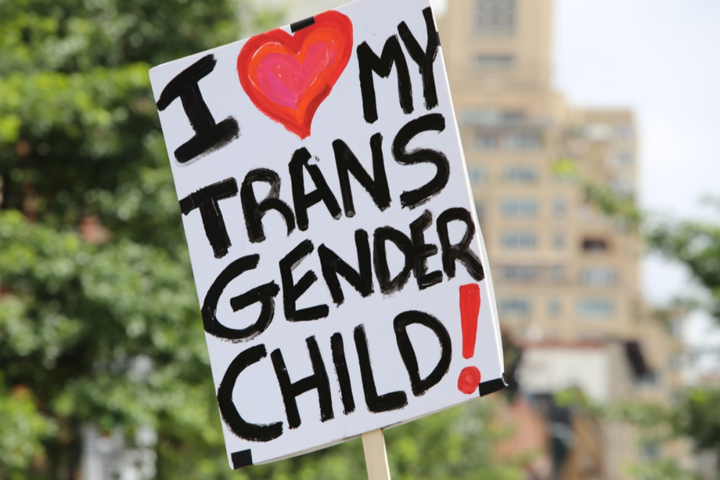
Gender Affirmation as a Social Determinant of Health
Society is stratified on the basis of gender affirmation – Who is deemed worthy of it and who isn’t.
Health inequities suffered by TGNB people are connected to a lack of gender affirmation.
Gender affirmation leads to better health outcomes for TGNB people. Social and psychological affirmation have the biggest positive impacts.
Family support for trans youth has been shown to lead to better mental health outcomes.
Pega, F., & Veale, J. F. (2015). The Case for the World Health Organization’s Commission on Social Determinants of Health to Address Gender Identity. American Journal of Public Health, 105(3). doi:10.2105/ajph.2014.302373
Glynn, T. R., Gamarel, K. E., Nemoto, T., & Operario, D. (n.d.). The Role of Gender Affirmation in Psychological Well-Being Among Transgender Women. PsycEXTRA Dataset. doi:10.1037/e504962016-001
Crosby, R. A., Salazar, L. F., & Hill, B. J. (2016). Gender Affirmation and Resiliency Among Black Transgender Women With and Without HIV Infection. Transgender Health, 1(1), 86-93. doi:10.1089/trgh.2016.0005
Notes:
Gender Affirmation – Having other people respect your gender identity – Is an example of a social determinant of health. Research shows that that gender affirmation leads to better health outcomes for trans and non-binary people. Two specific forms of affirmation seem to have the biggest positive impacts. Social affirmation occurs when other people respect your gender identity by referring to you by the correct pronouns and your chosen name. Psychological affirmation is internal – It’s self-acceptance. The body of research also shows that family support for trans youth leads to better mental health outcomes for those children.
We’ve covered a number of social determinants of health that impact LGBTQ people – What are the specific health disparities and inequities this community faces?

Slide 25
Deadnaming and Misgendering
Deadnaming is the act of referring to a transgender person by their birth name instead of their chosen name.
Misgendering refer to (someone, especially a transgender person) using a word, especially a pronoun or form of address, that does not correctly reflect the gender with which they identify.

Slide 26
Why is it Important to Get Names Right?
Most trans people have deeply negative, even traumatic experiences surrounding their deadnames.
Once they take they leap and decide to start using their chosen names, being addressed by their deadnames is invalidating of their identities, and can be triggering. Remember - TGNB folks disproportionately suffer from PTSD.
If we know a patient is trans, we must make every effort to avoid addressing them by their deadname, both verbally or in print.

Slide 27
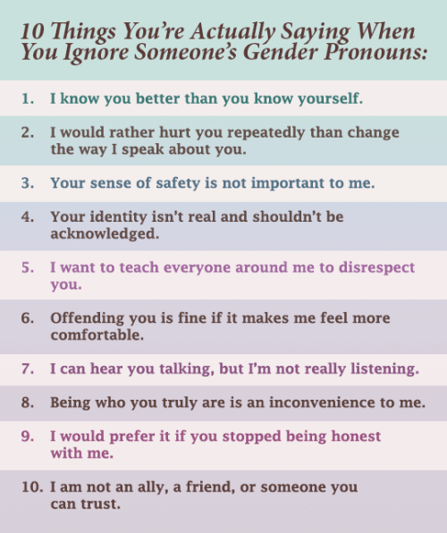
Why is it Important to Get Pronouns Right?
The person you are interacting with may have been misgendered earlier that day, maybe more than once.
Being misgendered is invalidating and somewhere between aggravating and traumatic.
Confirms trans folks’ worst fears about health care environments.
Can lead to trans & non-binary people falling out of care.

Slide 28
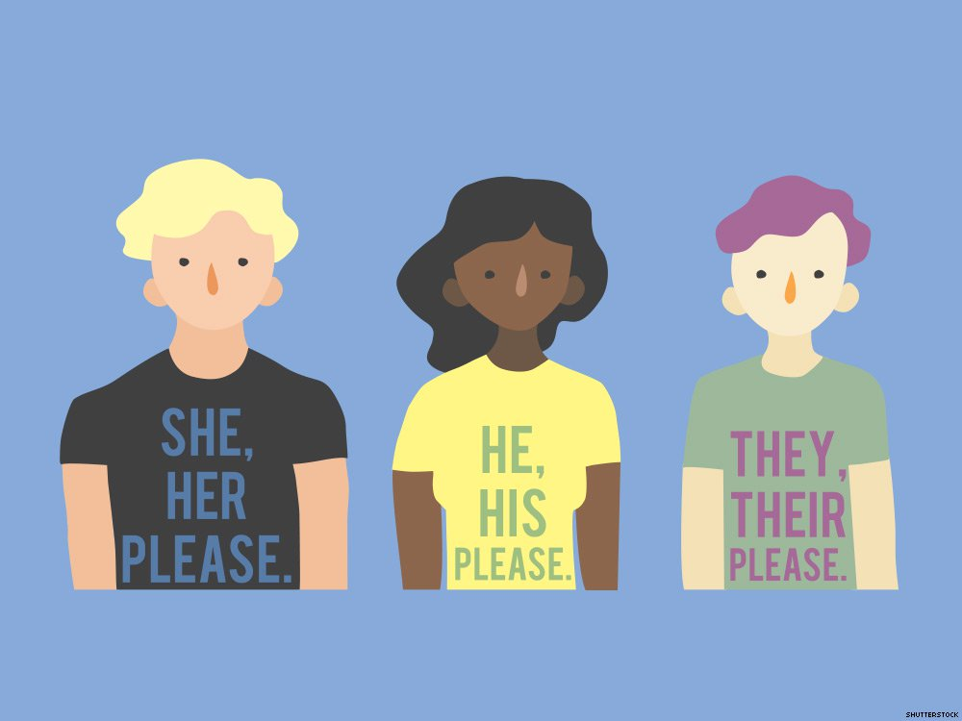
Best Practices for Pronoun Usage
Introduce yourself as “Hello, my name is _______, and my pronouns are _________.” This will cue the person you are talking to that it is OK to reciprocate.
Also, most TGNB people interpret this as a powerful sign of inclusiveness.
Wearing/displaying pronoun stickers/buttons also signals to TGNB people that you have considered pronouns.
IF/when you get someone’s pronouns wrong, apologize sincerely and quickly and then move on from it. Don’t dwell. Don’t keep apologizing, and don’t try to explain why or make it about yourself.
Notes:
Practice getting other people’s pronouns right even when they are not around, and correct other people when they get absent people’s pronouns wrong.
If you don’t know what a person’s pronouns are, default to using their name or the singular they (they/them/theirs).

Slide 29
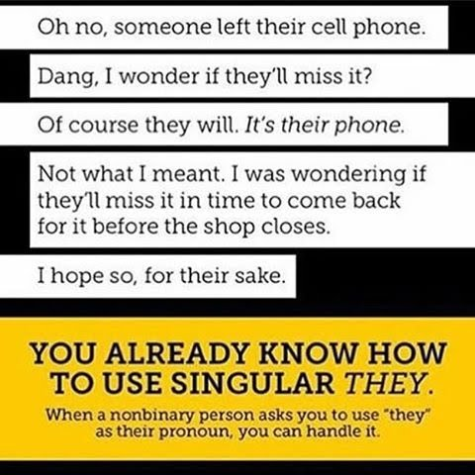
The Singular They & Gender-Inclusive Language
Most (but not all) non-binary people use they/them/theirs pronouns.
Some people are uncomfortable with this because they have been taught it’s “grammatically incorrect.”
It isn’t – In fact, the singular they was the American Dialect Society's 2015 Word of the Year.
Try to use gender-inclusive language. Instead of saying things like “hey ladies,” or “hey guys,” use terms like “folks,” “everyone,” or “y’all.”
Notes:
Most, but not all, non-binary people use they/them/theirs as their personal pronouns. Some people are uncomfortable with this because they argue that it’s “grammatically incorrect.” It isn’t. Language evolves and changes over time, and the singular they was the American Dialect Society’s 2015 Word of the Year. As you can see on the graphic on this slide, we already commonly use the singular they if we are talking about a third person who isn’t present and has unknown pronouns.
In addition, make an effort to use gender-inclusive language. Instead of saying things like “hey ladies” or “hey guys,” consider alternatives like “folks,” “everyone,” “distinguished guests,” ‘y’all,” and so on. Instead of saying that you need someone to “man” a table at an event, say that you need to “staff” the table, etc.

Slide 30
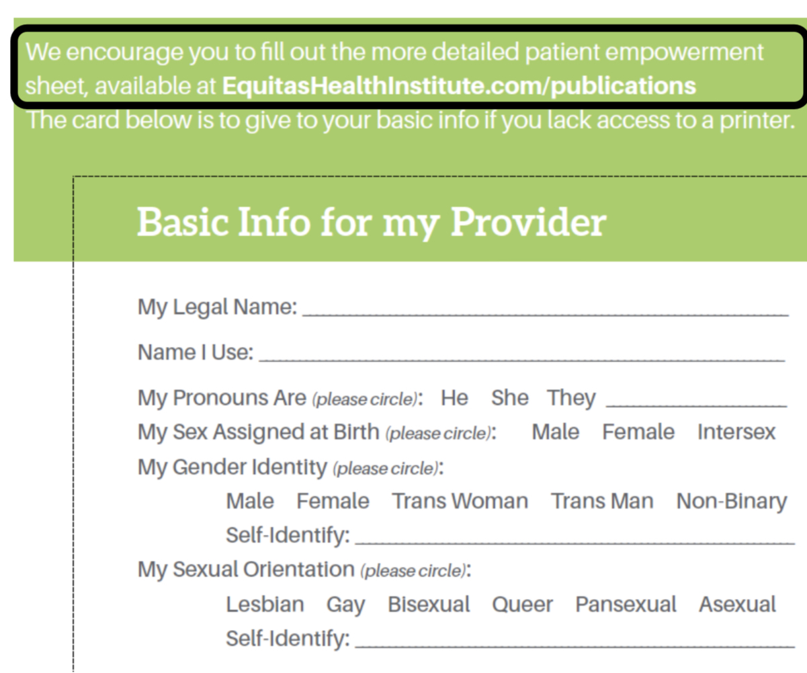
Creating a Safe and Inclusive Environment
There are many simple gestures you can make to signal that you are a “safe” person for LBTGQ+ folks.
Use best practices for pronoun usage
Wear pride pins or lanyards
Educate yourself on the resources available to various identities within this population and share that knowledge.
Strive for “Structural Competency.”
Notes:
There are many simple gestures you can make to signal that you are a “safe” person for LBTGQ+ folks.
Use best practices for pronoun usage
Wear pride pins or lanyards
Educate yourself on the resources available to various identities within this population and share that knowledge.
Strive for “Structural Competency.”
How are questions asked on forms?
Who is represented on brochures and magazines in waiting areas?
Are there signals of LGBTQ+ inclusiveness, such as rainbow stickers, etc?

Slide 31
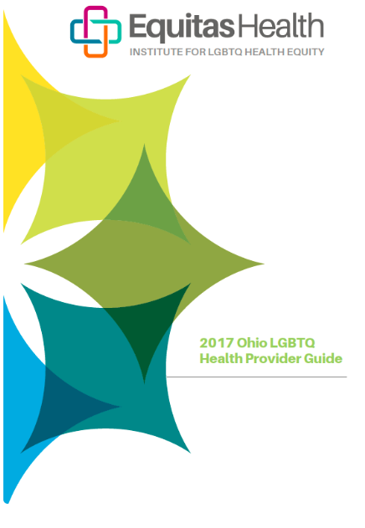

Providing Structurally Competent and Culturally Humble Services
Recognize one’s own bias.
Refrain from making assumptions.
Use inclusive language.
Consider pronouns.
Make forms inclusive.
Know community resources.
Identify oneself as an ally.
Place your nondiscrimination policy (inclusive of SOGI) on display

Slide 32
Impact of Providing Culturally Humble Services
Closing health disparities.
Achieving health equity.
Improving health outcomes.
Increasing “community trust” of health care establishments.
Creating safe spaces.
Decrease in ability of stigma to function as a barrier to care.

Slide 33

Questions?
Zoe E. R. Fawcett, MA
Education Manager
She/her/hers
  Phone: 614-643-6847
  Email: zoefawcett@equitashealth.com

