Slide 1

CHFS ANNUAL MEETING
April 14, 2014
Baby Basics
John Ladd, MNO
Cuyahoga County Office of Early Childhood
Invest in Children

Slide 2
● An Early Childhood System
Resources
Public
Private
Invest in Children
Coordination
Evaluation
Results
Young children thrive and are ready for school.
Prioritization
Innovation
Advocacy
Organized under the Cuyahoga County Office of Early Childhood.

Slide 3
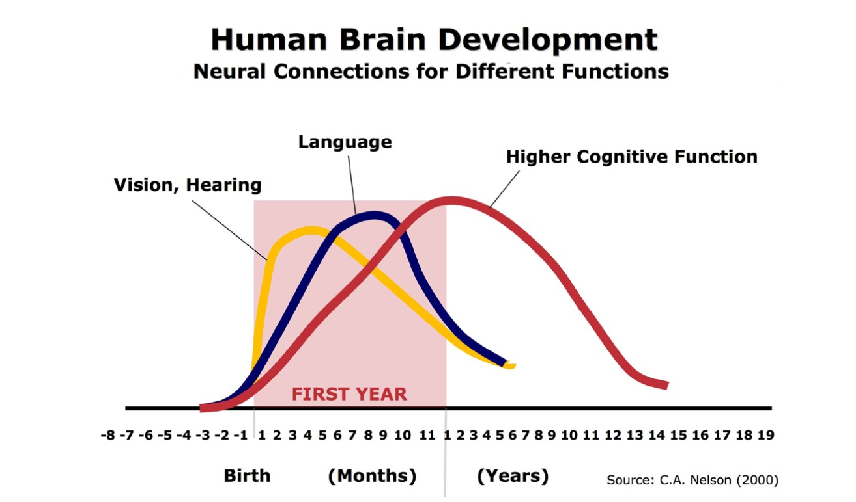
● Why Invest in Children?
Harvard University – Center on the Developing Child

Slide 4
● Why Baby Basics?
15,108 births in Cuyahoga County in 2012
  10.4% Low Birth Weight
  14.1% Preterm
  13.2% Maternal Smoking
  69.8% 1st Trimester Prenatal
  16.7 Teen Birth Rate (15-17)
  9.1 Infant Mortality Rate
  42.9% Medicaid births
All rates need improvement & all are worse than Ohio rates, except maternal smoking

Slide 5

THE WHAT TO EXPECT
FOUNDATION
Nonprofit foundation based in NYC
Takes name from What to Expect When You’re Expecting
Purpose is to create innovative programming that helps low income women get education & support needed to have healthier babies.
Baby Basics has reached over half-a-million mothers across US

Slide 6

BABY BASICS OBJECTIVES
Provide easy-to-read prenatal materials for learning and family literacy.
Empower underserved parents to be active participants and effectively navigate the healthcare system.
Teach healthcare providers to incorporate health literacy & cultural competency into daily practice.
Build community initiatives so families receive consistent, comprehensive, integrated, prenatal care information.

Slide 7
BABY BASICS MATERIALS
Baby Basics book addresses the economic, social, & cultural issues that many pregnant women face containing evidence-based health information meeting ACOG standards
The Baby Basics planner helps pregnant women get organized providing space to record appointments, test results, provider’s instructions, and write questions
Baby Basics posters & supporting materials promote the program
The Baby Basics Moms Club curriculum enables trained staff from health systems and community-based programs to facilitate group education classes for pregnant clients

Slide 8
BABY BASICS IN CLEVELAND
Cleveland Department of Health MomsFirst, Greater Cleveland Family Support Consortium, NEON, & Neighborhood Family Practice began Baby Basics Cleveland program in 2008. Sisters of Charity provided funding.
Target population – women/teens at risk for poor birth outcomes & women/teens incarcerated.
Goals – improve health care decisions/outcomes; enhance communications; create community collaborations; strengthen evidence base.

Slide 9
BABY BASICS IN CLEVELAND
Books and planners provided
Training conducted
Used in all MomsFirst home visiting
Used in 5 clinical sites
Moms Clubs established

Slide 10
BABY BASICS CLEVELAND RESULTS
466 clients showed significant improvements on health literacy self-efficacy scale, healthcare utilization scale, and perceived overall health.
78% clients looked at BB book 3 or more times when they had a question; 99% indicated very or somewhat helpful; 93% reported they learned new information.
After training, practitioners indicated greater confidence in communicating with patients and motivating behavior change.

Slide 11

CUYAHOGA COUNTY ROLE
Invest in Children has agreed to investigate the feasibility of expansion county-wide and the structure/steps needed.
WTEF has provided funding to conduct planning
Consultant was selected to assist with process
Plan will be completed by end of 2014

Slide 12

PLANNING PROCESS
Interviews with local and national stakeholders
Focus groups with users.
Presentations to related initiatives to educate, obtain input, and identify methods to integrate and compliment efforts
2 community planning meetings – first meeting April 17, 2014 at 2:30 p.m.
3 Task Force meetings – first meeting June 19, 2014 at 2:30 p.m.
Final plan by December, 2014.

Slide 13


ISSUES TO ADDRESS IN PLAN
Level of community commitment/investment in offering Baby Basics
Target audience – pregnant moms & agencies that serve them
Policies and procedures
Roles and responsibilities
Communications and training
Data and evaluation
Budget
Location and sustainability
Implementation schedule

Slide 14
Please join our efforts – sign up to receive more information
Invest In Children
Lead Agencies
● ADAMHS Board
● Cleveland Department of
Public Health
● Cuyahoga County Board
of Health
● Help Me Grow
● The Literacy Cooperative
● Starting Point
Invest In Children
Office of Early Childhood
310 W. Lakeside Avenue, Suite 565
Cleveland, OH 44113
216-698-2215
Jladd@cuyahogacounty.us

